Slide 1


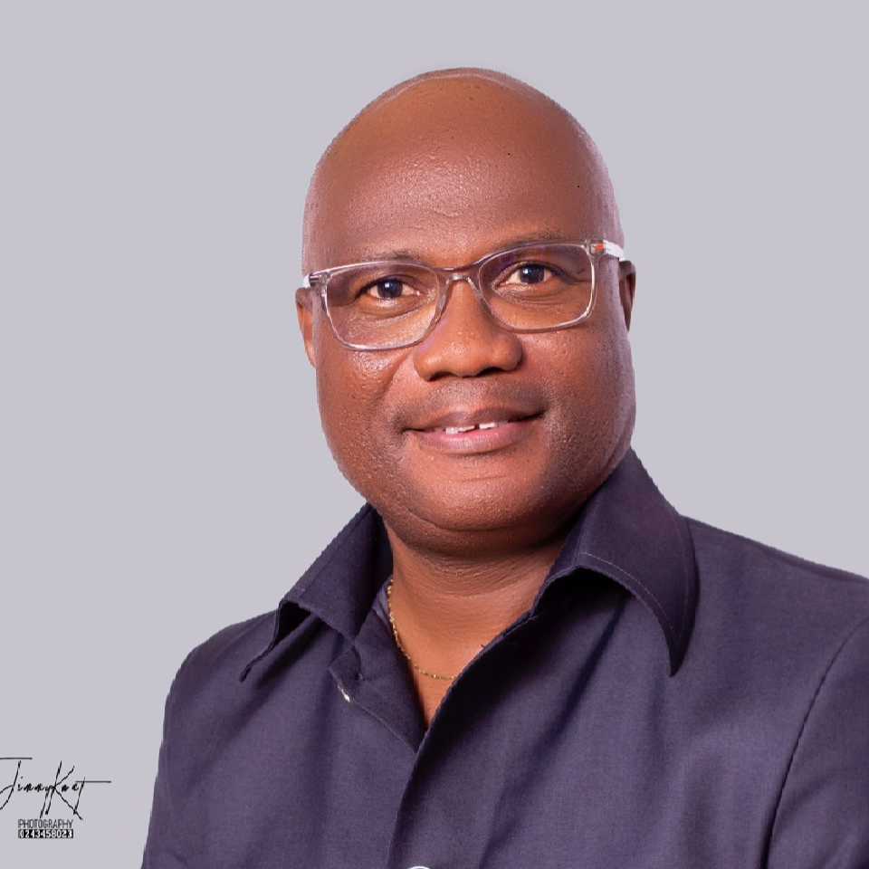
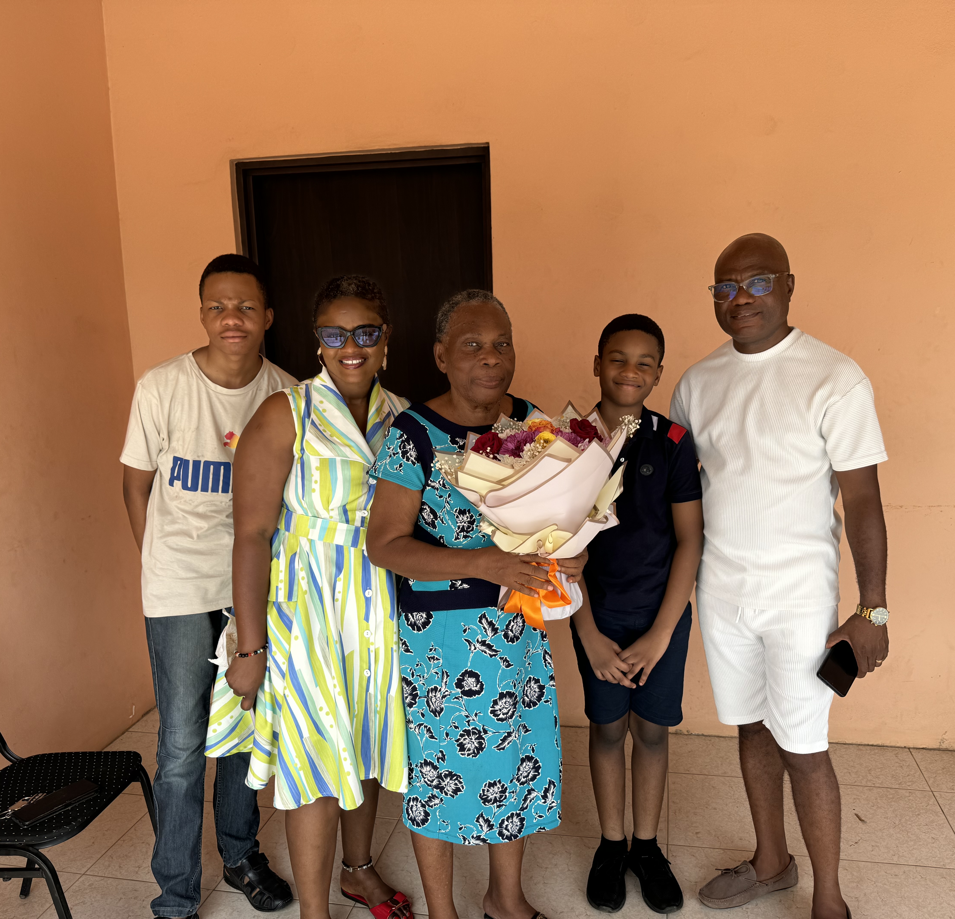
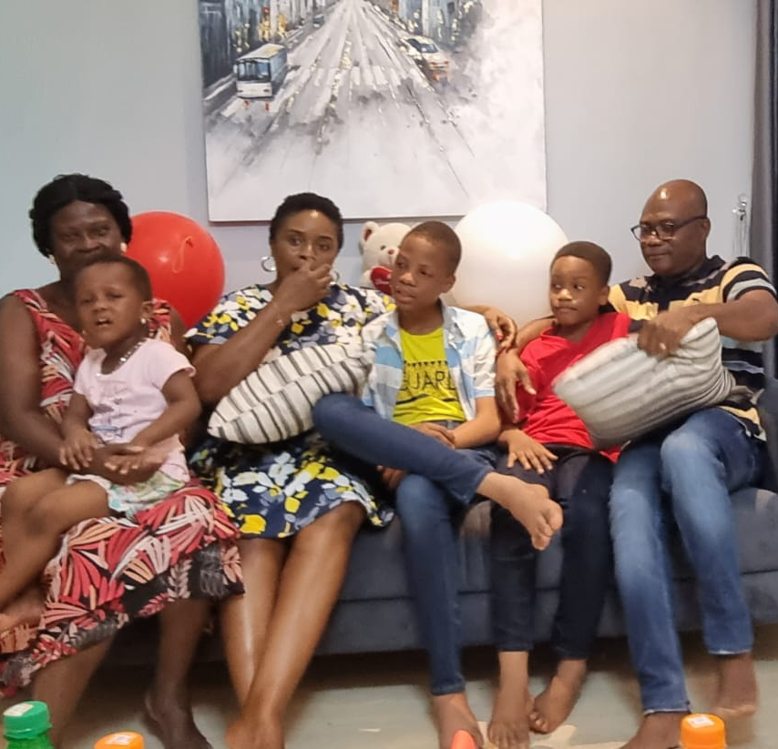
Getting to Know Me
Work
Personal
My role
Sustainability Operations Manager
Significant others / family members / furry friends in my life
My mum-Rosina, wife-Anna and my two boys-William and Ivan.
Tenure in ofi/Olam
14 years
How I enjoy spending my free time
Having time with my family, listening to classical or jazz music, and watching tennis/basket ball
Previous companies I have worked at
Iirrigation Development Authority, African Connections, Teaching of science-2nd c cycle institution
My favorite / comfort food
Banku with okro stew with wele
Why I joined ofi/Olam and what keeps me here?
I joined ofi/olam to make a living, but over the years I have developed a passion to helping the rural communities and putting a smile on the faces of farmers. This is what keeps me with ofi.
My favorite song
Sweet Rum and starlight-Earl Klugh
Isaac Sackey
‘K.B’
A few fun facts about me
They say I am a husband to all females at work-I say I’m just committed to making sure every woman wins.
By day, I run sustainability operations. By night I relax to Mozart, Earl Klugh and the sound of impact reports being submitted on time.
This is me outside work, doing stuff I enjoy in my life …

